Slide 1
Consumer 360 Analytics Dashboard
Customer Retention & Revenue Insights

Slide 2
Business Problem
Retail companies lack visibility into:
• Customer retention patterns • Revenue drivers • Churn risk customers
Goal: Build an automated analytics pipeline to generate actionable insights for decision-making.

Slide 3
Data Pipeline Architecture
Raw Retail Dataset (CSV)
⬇
Python ETL Script (Data Cleaning + Feature Engineering)
⬇
PostgreSQL Database
⬇
Power BI Dashboard
⬇
Executive Insights & Decision Making

Slide 4
Analytics Implemented
• Cohort Analysis – Customer retention over time
• Market Basket Analysis – Frequently bought products
• Revenue Analysis – Revenue trends and drivers
• Key Influencers – Identify factors impacting revenue

Slide 5
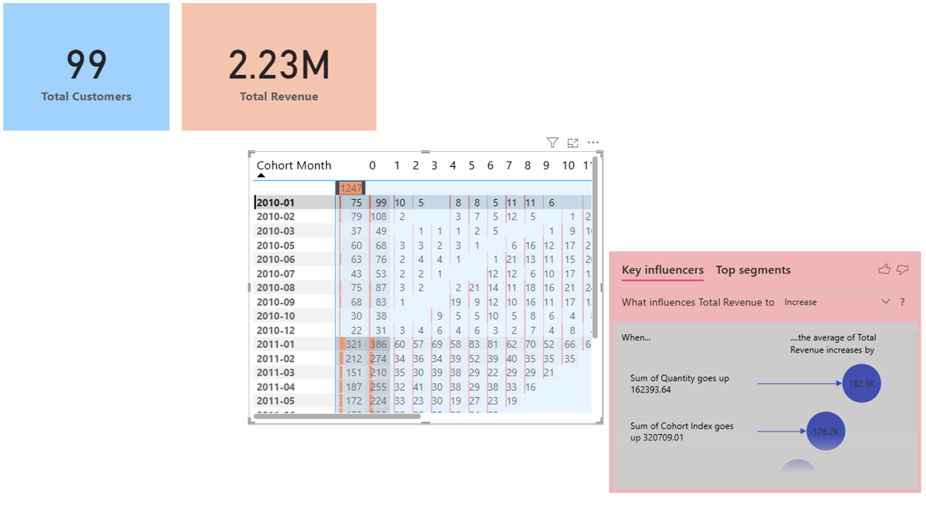
Dashboard Insights
Key findings from the dashboard:
• Revenue strongly influenced by purchase quantity • Customer retention decreases after initial months • Repeat customers generate most of the revenue

Slide 6
Churn Risk Customers
Customers inactive for 90+ days are identified as churn risk.
Business value:
• Target marketing campaigns • Improve customer retention • Increase repeat purchases

Slide 7
Business Impact
Benefits of this solution:
• Automated ETL pipeline using Python • Centralized database in PostgreSQL • Interactive Power BI dashboard • Data-driven decision making • Identification of churn risk customers

